Slide 1


Noida Institute of Engineering and Technology, Greater Noida
KCS 501
Database Management System
Unit: 3
Database Design & Normalization
Ram Kumar Sharma
Assistant Prof. IT Deptt.
NIET Gr Noida
Course Details B.Tech. (IT) 5th Sem

Slide 2
Content
Syllabus of Unit 3
Course Objective of Unit 3
Course outcome of Unit 3
CO-PO mapping
CO PSO mapping
Prerequisite and Recap
Design Guidelines for Relational Databases
Functional Dependency
Types of FDs
Closure of a Set of Functional Dependencies
Inference Rules of Functional Dependencies
Example
Procedure for Computing F⁺
Closure of Attribute Sets
Example of Attribute Set Closure

Slide 3
Content (contd..)
Canonical Cover
Extraneous Attributes
Testing if an Attribute is Extraneous
The evil of redundancy
Normalization of Relations
Keys and Attributes Participating in Keys
Types of Normal Form
First Normal Form
Second Normal Form
Third Normal Form
BCNF
Lossless Join Decomposition
Dependency Preservation
Multivalued Dependency
Inference Rule of Multivalued Dependency

Slide 4
Content (contd..)
Fourth Normal Form
Join Dependency
Fifth Normal Form
Domain-Key Normal Form (DKNF)
Youtube & NPTEL Video Links
MCQ
Weekly Assignment
Old Question Papers
References

Slide 5
Syllabus of Unit 3
Data Base Design & Normalization: Functional dependencies, normal forms, first, second, 8 third normal forms, BCNF, inclusion dependence, loss less join decompositions, normalization using FD, MVD, and JDs, alternative approaches to database design

Slide 6
Course Objective of Unit 3
Designing of Good database
Decomposition of relation in certain normal form to avoid the anomalies

Slide 7
Course Outcomes of Unit 3
At the end of semester students will be able
CO2 | Apply query processing techniques to automate the real time problems of databases
CO3 | Identify and solve the redundancy problem in database tables using normalization.
CO5 | To manage data efficiently by using a database management system. Normalization process reduces the update, insert and deletion anomalies when there is change in database.

Slide 8
CO-PO Mapping
co-po correlation matrix
co.k | po1 | po2 | po3 | po4 | po5 | po6 | po7 | po8 | po9 | po10 | po11 | po12
RCS-501.5 | 2 | 3 | 2 | 2 | 2 | 3 | 2 | 2 | 3 | 2 | 2 | 2
RCS-501.1 | 2 | 2 | 3 | 3 | 3 | 2 | 3 | 2 | 2 | 2 | 2 | 3
RCS-501.2 | 3 | 3 | 3 | 2 | 2 | 2 | 2 | 2 | 2 | 2 | 2 | 3

Slide 9
CO-PSO Mapping
co.k | pso1 | pso2 | pso3 | pso4
rcs-501.5 | 2 | 3 | 3 | 3

Slide 10
Prerequisite and Recap
Relational Data Model
Anomalies associated with data model

Slide 11
Content unit 3 (Lecture 14)
Design Guidelines for Relational Databases
Functional Dependency
Types of FDs
Closure of a Set of Functional Dependencies
Inference Rules of Functional Dependencies
Example
Procedure for Computing F⁺

Slide 12
Prerequisite Unit 3 Lect. 14
Set theory
Mathematical operations
Discrete Mathematics

Slide 13
Topic mapping with CO
Topic | CO
Design Guidelines for Relational Databases | CO2 , CO3, CO5
Functional Dependency Types of FDs Closure of a Set of Functional Dependencies Procedure for Computing F⁺ | CO2 , CO3
Inference Rules of Functional Dependencies Example | CO2 , CO3
Procedure for Computing F⁺ | CO2 , CO3

Slide 14
Topic Objectives
Topic | Objectives
Design Guidelines for Relational Databases | Students will be able to convert ER diagram into relational model using these guidelines
Functional Dependency Types of FDs Closure of a Set of Functional Dependencies Procedure for Computing F⁺ | Students will be able to understand the concept of FD and its type , they will also be able to compute closure of attributes and FDs
Inference Rules of Functional Dependencies Example | Students will be able to apply inference rule to find the keys
Procedure for Computing F⁺ | Students will be able to compute F⁺

Slide 15
Design Guidelines for Relational Databases
Decide whether a particular relation R is in “good” form.
Whether RDBMS follows the Codd Rules ?
In the case that a relation R is not in “good” form, decompose it into a set of relations {R₁, R₂, ..., R_{n}} such that
each relation is in good form
the decomposition is a lossless-join decomposition
Our theory is based on:
functional dependencies
multivalued dependencies

Slide 16
Functional Dependency (CO2,CO3, CO5)
Constraints on the set of legal relations.
Require that the value for a certain set of attributes determines uniquely the value for another set of attributes.
A functional dependency is a generalization of the notion of a key.

Slide 17
Functional Dependency (Cont.) (CO2,CO3, CO5)
Let R be a relation schema
α ⊆ R and β ⊆ R
The functional dependency
α → β holds on R if and only if for any legal relations r(R), whenever any two tuples t₁ and t₂ of r agree on the attributes α, they also agree on the attributes β. That is,
t₁[α] = t₂ [α] ⇒ t₁[β ] = t₂ [β ]
Example: Consider r(A,B ) with the following instance of r.
On this instance, A → B does NOT hold, but B → A does hold.
4
1 5
3 7

Slide 18
Functional Dependency (Cont.) (CO2,CO3, CO5)
K is a superkey for relation schema R if and only if K → R
K is a candidate key for R if and only if
K → R, and
for no α ⊂ K, α → R
Functional dependencies allow us to express constraints that cannot be expressed using superkeys. Consider the schema:
bor_loan = (customer_id, loan_number, amount ).
We expect this functional dependency to hold:
loan_number → amount
but would not expect the following to hold:
amount → customer_name

Slide 19
Functional Dependency (Cont.) (CO2,CO 3)
A functional dependency is trivial if it is satisfied by all instances of a relation
Example:
customer_name, loan_number → customer_name
customer_name → customer_name
In general, α → β is trivial if β ⊆ α

Slide 20
Types of FDs (CO2, CO 3)
Fully functional dependency
A functional dependency P-> Q is FFD if removal of any attribute from P dependency does not hold any more.
Partial Dependency
If a Non prime or Non key attribute of the relation is dependent on only a part of the candidate key then such dependency is defined as partial dependency.
Consider R=(A,B,C,D,E) WHERE CK=AB and FD=AB->CDE then A-> C,A->D,A->E if exist in R, ARE ALL PARTIAL DEPENDENCIES

Slide 21
Types of FDs (CO2, CO 3)
Trivial functional dependency
A FD X → Y is trivial Functional Dependency if Y is a subset of X.
Example :{Emp_id, Emp_name} -> Emp_id is a trivial functional dependency as Emp_id is a subset of {Emp_id,Emp_name}.
Non-trivial functional dependency
A FD X → Y is non trivial Functional Dependency if Y is not a subset of X.
Transitive dependency
A FD is called transitive FD if non key attribute transitively depends on key attribute .
Let X → Y, and Y→ Z exist in R then R also holds X→Z.

Slide 22
Inference Rules of Functional Dependencies (CO2, CO 3)
We can find all of F⁺ by applying Armstrong’s Axioms:
if β ⊆ α, then α → β (reflexivity)
if α → β, then γ α → γ β (augmentation)
if α → β, and β → γ, then α → γ (transitivity)
These rules are
sound (generate only functional dependencies that actually hold) and
complete (generate all functional dependencies that hold).

Slide 23
Inference Rules of Functional Dependencies (CO2,CO 3)
We can further simplify manual computation of F⁺ by using the following additional rules.
If α → β holds and α → γ holds, then α → β γ holds (union)
If α → β γ holds, then α → β holds and α → γ holds (decomposition)
If α → β holds and γ β → δ holds, then α γ → δ holds (pseudotransitivity)
The above rules can be inferred from Armstrong’s axioms.

Slide 24
Closure of a Set of Functional Dependencies (CO2, CO 3)
Given a set F of functional dependencies, there are certain other functional dependencies that are logically implied by F.
For example: If A → B and B → C, then we can infer that A → C
The set of all functional dependencies logically implied by F is the closure of F.
We denote the closure of F by F⁺.
F⁺ is a superset of F.

Slide 25
Procedure for Computing F⁺ (CO2, CO 3)
To compute the closure of a set of functional dependencies F: F ⁺ = F repeat for each functional dependency f in F⁺ apply reflexivity and augmentation rules on f add the resulting functional dependencies to F ⁺ for each pair of functional dependencies f₁and f₂ in F ⁺ if f₁ and f₂ can be combined using transitivity then add the resulting functional dependency to F ⁺ until F ⁺ does not change any further

Slide 26
Example (CO2,CO 3)
R = (A, B, C, G, H, I) F = { A → B, A → C, CG → H, CG → I, B → H}
some members of F⁺
A → H
by transitivity from A → B and B → H
AG → I
by augmenting A → C with G, to get AG → CG and then transitivity with CG → I
CG → HI
by augmenting CG → I to infer CG → CGI,
and augmenting of CG → H to infer CGI → HI, and then transitivity

Slide 27
Content unit 3 (Lecture 15, 16, 17, 18)
Closure of Attribute Sets
Example of Attribute Set Closure
Canonical Cover
Extraneous Attributes
Testing if an Attribute is Extraneous
The evil of redundancy
Normalization of Relations
Keys and Attributes Participating in Keys
Types of Normal Form
First Normal Form
Second Normal Form
Third Normal Form
BCNF

Slide 28
Prerequisite Unit 3 Lect. 15,16,17,18
Set theory
Mathematical operations
Discrete Mathematics

Slide 29
Topic mapping with CO
Topic | CO
Canonical Cover Extraneous Attributes Testing if an Attribute is Extraneous | CO5
The evil of redundancy Normalization of Relations Keys and Attributes Participating in Keys | CO5
Types of Normal Form First Normal Form Second Normal Form Third Normal Form BCNF | CO5

Slide 30
Topic Objectives
Topic | Objectives
Canonical Cover Extraneous Attributes Testing if an Attribute is Extraneous | Students will be able to find canonical covers
The evil of redundancy Normalization of Relations Keys and Attributes Participating in Keys | Students will be able to know drawbacks of redundancy in data base
Types of Normal Form First Normal Form Second Normal Form Third Normal Form BCNF | Students will be able to apply normalization process to get a efficient data base

Slide 31
Closure of Attribute Sets (CO5)
Given a set of attributes α, define the closure of α under F (denoted by α⁺) as the set of attributes that are functionally determined by α under F
Algorithm to compute α⁺, the closure of α under F
result := α; while (changes to result) do for each β → γ in F do begin if β ⊆ result then result := result ∪ γ end

Slide 32
Example of Attribute Set Closure (CO5)
R = (A, B, C, G, H, I)
F = {A → B, A → C , CG → H, CG → I, B → H}
(AG)⁺
1. result = AG
2. result = ABCG (A → C and A → B)
3. result = ABCGH (CG → H and CG ⊆ AGBC)
4. result = ABCGHI (CG → I and CG ⊆ AGBCH)
Is AG a candidate key?
Is AG a super key?
Does AG → R? == Is (AG)⁺ ⊇ R
Is any subset of AG a superkey?
Does A → R? == Is (A)⁺ ⊇ R
Does G → R? == Is (G)⁺ ⊇ R

Slide 33
Canonical Cover (CO5)
Sets of functional dependencies may have redundant dependencies that can be inferred from the others
For example: A → C is redundant in: {A → B, B → C}
Parts of a functional dependency may be redundant
E.g.: on RHS: {A → B, B → C, A → CD} can be simplified to {A → B, B → C, A → D}
E.g.: on LHS: {A → B, B → C, AC → D} can be simplified to {A → B, B → C, A → D}
Intuitively, a canonical cover of F is a “minimal” set of functional dependencies equivalent to F, having no redundant dependencies or redundant parts of dependencies `

Slide 34
Extraneous Attributes (CO5)
Consider a set F of functional dependencies and the functional dependency α → β in F.
Attribute A is extraneous in α if A ∈ α and F logically implies (F – {α → β}) ∪ {(α – A) → β}.
Attribute A is extraneous in β if A ∈ β and the set of functional dependencies (F – {α → β}) ∪ {α →(β – A)} logically implies F.
Example: Given F = {A → C, AB → C }
B is extraneous in AB → C because {A → C, AB → C} logically implies A → C (I.e. the result of dropping B from AB → C).
Example: Given F = {A → C, AB → CD}
C is extraneous in AB → CD since AB → C can be inferred even after deleting C

Slide 35
Testing if an Attribute is Extraneous (CO5)
Consider a set F of functional dependencies and the functional dependency α → β in F.
To test if attribute A ∈ α is extraneous in α
compute ({α} – A)⁺ using the dependencies in F
check that ({α} – A)⁺ contains β; if it does, A is extraneous in α
To test if attribute A ∈ β is extraneous in β
compute α⁺ using only the dependencies in F’ = (F – {α → β}) ∪ {α →(β – A)},
check that α⁺ contains A; if it does, A is extraneous in β

Slide 36
Canonical Cover (CO 5)
A canonical cover for F is a set of dependencies F_{c} such that
F logically implies all dependencies in F_{c,} and
F_{c} logically implies all dependencies in F, and
No functional dependency in F_{c} contains an extraneous attribute, and
Each left side of functional dependency in F_{c} is unique.

Slide 37
Canonical Cover (CO 5)
To compute a canonical cover for F: Step-1 :
Decompose the functional dependencies using Decomposition rule(Armstrong’s Axiom) i.e. single attribute on right hand side.
Step-2 :
Remove extraneous attributes from LHS of functional dependencies by calculating the closure of FD’s having two or more attributes on LHS.
Step-3 :
Remove FD’s having transitivity.

Slide 38
Steps To Find Canonical Cover-
Consider a relation R(A,B,C,D) having some attributes and below are mentioned functional dependencies.
FD1 : B → A
FD2 : AD → C
FD3 : C → ABD
Solution

Slide 39
Canonical cover(CO 5)
Exercise 2 :
Let R = (A, B, C) with Functional Dependencies F = {A → BC B → C A → B AB → C}
Find the canonical Cover .

Slide 40
(CO 5)
Problem:
The following functional dependencies hold true for the relational scheme R ( W , X , Y , Z ) –
X → W
WZ → XY
Y → WXZ
Write the irreducible equivalent for this set of functional dependencies.

Slide 41
The evil of Redundancy (CO 5)
Redundancy is at the root of several problems associated with relational schemas:
Information is stored redundantly
Wastes storage
Causes problems with update anomalies
Insertion anomalies
Deletion anomalies
Modification anomalies

Slide 42
Normalization of Relations (CO 5)
Normalization:
The process of decomposing unsatisfactory "bad" relations by breaking up their attributes into smaller relations
Normal form:
Condition using keys and FDs of a relation to certify whether a relation schema is in a particular normal form

Slide 43
Keys and Attributes Participating in Keys(CO 5)
superkey uniquely identify the tuple in a relation
candidate key is a minimal set of super key
If a relation schema has more than one key, each is called a candidate key.
One of the candidate keys is arbitrarily designated to be the primary key, and the others are called secondary keys.
A Prime attribute must be a member of some candidate key
A Nonprime attribute is not a prime attribute—that is, it is not a member of any candidate key.

Slide 44
Types of Normal Form (CO 5)
1NF, 2NF, 3NF, BCNF
based on keys and FDs of a relation schema
4NF
based on keys, multi-valued dependencies : MVDs;
5NF
based on keys, join dependencies : JDs

Slide 45
First Normal Form (CO 5)
A relation R is in 1NF if and only if it has only single-valued attributes (atomic values)
EMP_PROJ (SSN, PNO, HOURS, ENAME, PNAME, PLOCATION)
PLOCATION is not in 1NF (multi-valued attrib.)
solution: decompose the relation
EMP_PROJ2 (SSN, PNO, HOURS, ENAME, PNAME)
LOC (PNO, PLOCATION)

Slide 46
Second Normal Form (CO 5)
A relation R in 2NF if and only if it is in 1NF and every nonkey column depends on a key not a subset of a key
all nonprime attributes of R must be fully functionally dependent on a whole key(s) of the relation, not a part of the key
no violation: single-attribute key or no nonprime attribute

Slide 47
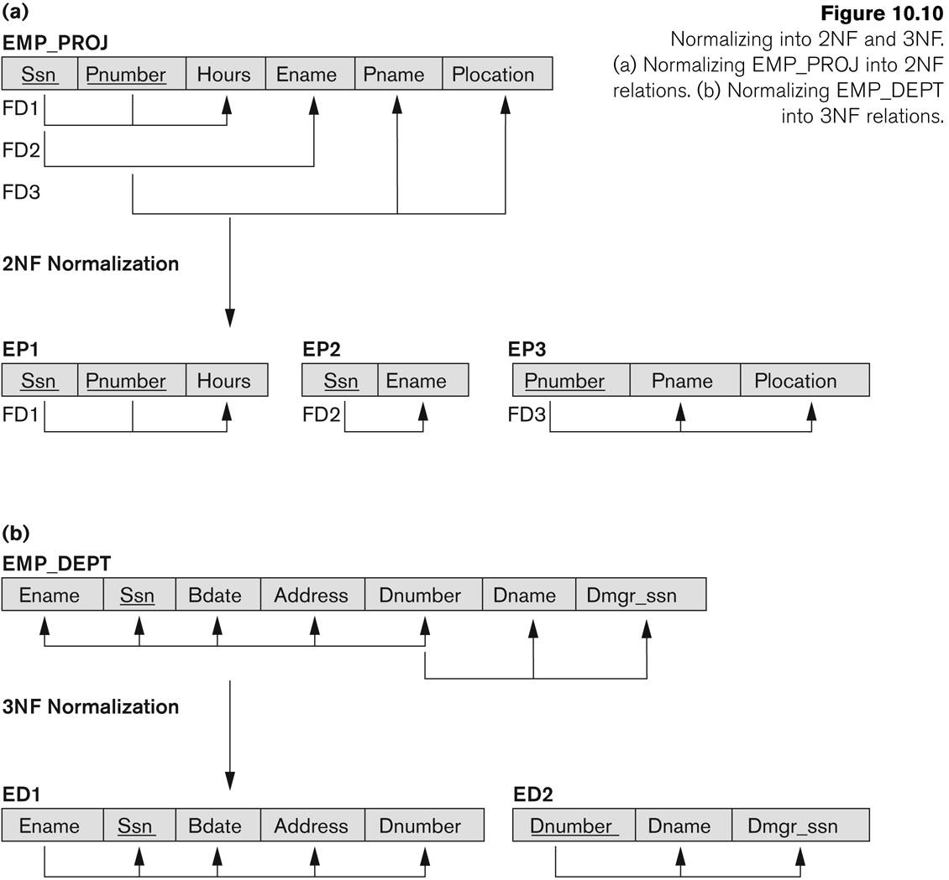
Second Normal Form (CO 5)

Slide 48
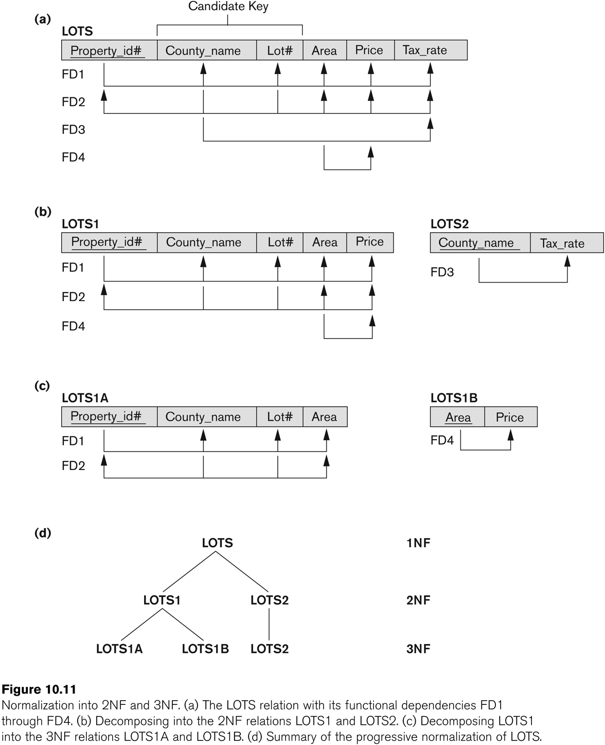
Second Normal Form (CO 5)

Slide 49
Third Normal Form (CO 5)
Definition:
Transitive functional dependency: a FD X -> Z that can be derived from two FDs X -> Y and Y -> Z
Examples:
SSN -> DMGRSSN is a transitive FD
Since SSN -> DNUMBER and DNUMBER -> DMGRSSN hold
SSN -> ENAME is non-transitive
Since there is no set of attributes X where SSN -> X and X -> ENAME

Slide 50
Third Normal Form (CO 5)
A relation schema R is in third normal form (3NF) if it is in 2NF and no non-prime attribute A in R is transitively dependent on the primary key
R can be decomposed into 3NF relations via the process of 3NF normalization
NOTE:
In X -> Y and Y -> Z, with X as the primary key, we consider this a problem only if Y is not a candidate key.
When Y is a candidate key, there is no problem with the transitive dependency .
E.g., Consider EMP (SSN, Emp#, Salary ).
Here, SSN -> Emp# -> Salary and Emp# is a candidate key.

Slide 51
BCNF (Boyce-Codd Normal Form) (CO 5)
A relation schema R is in Boyce-Codd Normal Form (BCNF) if whenever an FD X -> A holds in R, then X is a superkey of R
Each normal form is strictly stronger than the previous one
Every 2NF relation is in 1NF
Every 3NF relation is in 2NF
Every BCNF relation is in 3NF
There exist relations that are in 3NF but not in BCNF
The goal is to have each relation in BCNF (or 3NF)

Slide 52
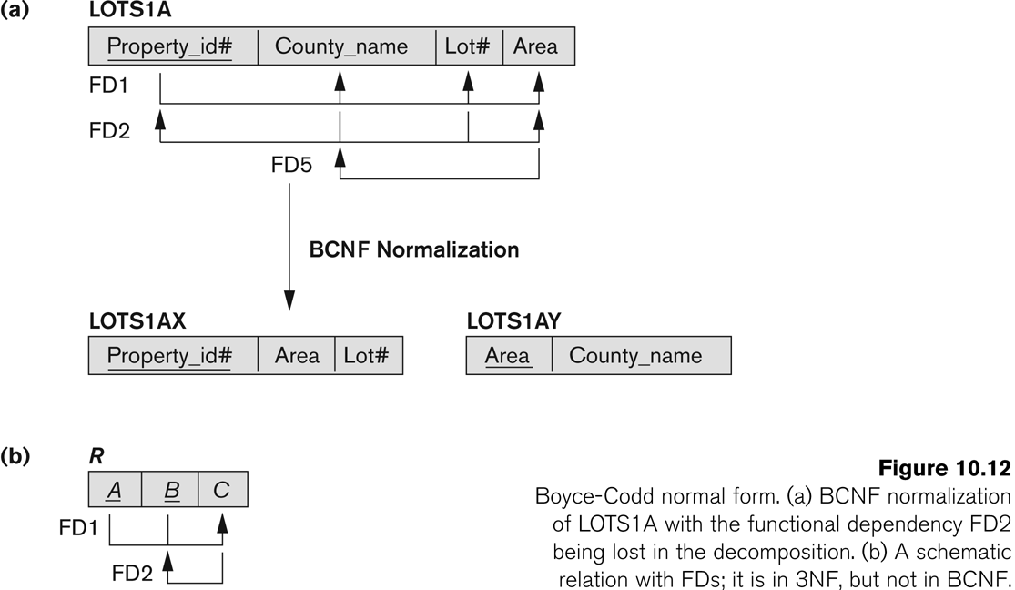
BCNF (Boyce-Codd Normal Form) (CO 5)

Slide 53
BCNF (Boyce-Codd Normal Form) (CO 5)
A relation schema R is in Boyce-Codd Normal Form (BCNF) if whenever an FD X -> A holds in R, then X is a superkey of R
Each normal form is strictly stronger than the previous one
Every 2NF relation is in 1NF
Every 3NF relation is in 2NF
Every BCNF relation is in 3NF
There exist relations that are in 3NF but not in BCNF
The goal is to have each relation in BCNF (or 3NF)

Slide 54
BCNF (Boyce-Codd Normal Form) (CO 5)

Slide 55
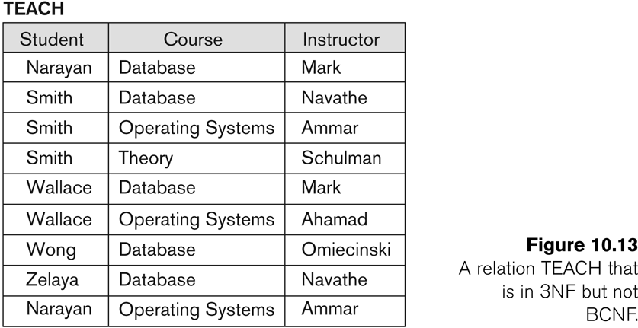
a relation TEACH that is in 3NF but not in BCNF
(CO 5)

Slide 56
Lossless Join Decomposition (CO 5)
Let a relation R ,decomposed into relations R1 and R2,
Decomposition is lossy if R1 ⋈ R2 ⊃ R
Decomposition is lossless if R1 ⋈ R2 = R
To check for lossless join decomposition using FD set, following conditions must hold:
Union of Attributes of R1 and R2 must be equal to attribute of R. Each attribute of R must be either in R1 or in R2.
Att(R1) U Att(R2) = Att(R)
Intersection of Attributes of R1 and R2 must not be NULL.
Att(R1) ∩ Att(R2) ≠ Φ
Common attribute must be a key for at least one relation
(R1 or R2) Att(R1) ∩ Att(R2) -> Att(R1) or Att(R1) ∩ Att(R2) -> Att(R2)

Slide 57
Dependency Preserving Decomposition (CO 5)
Decomposition of a relation R into relations R1 and R2, if
All dependencies of R either must be a part of R1 or R2 or must be derivable from combination of FD’s of R1 and R2.

Slide 58
Weekly Assignment 3.1
Let R(B,O,I,S,Q,D) {S→D,I→B,IS →Q,B →O} find keys for R. CO5
ConsiderR(A,B,C,D)andF={A → BC,AC →D,D →B,AB →D} determine if the attributes set {A}, {BD},&{AC} are super keys for this relation. CO5
Suppose we have a relation ABCD with some FDs as follows
F={AB →C,C →D,D →A}
compute closure A,C,AB,AC and all FDs that follows from F. CO5
4. Given two set of FDs F1,F2for the relation(A,B,C,D,E), F1={A→B,AB →C, D →AC,D→E},F2={A→BC,D→AE}.Are F1 and F2 equivalent? Explain. CO5
5. Define closure of a CD set. Consider the relation schema R(A,B,C,D,E,G) with followingFDs F={AB→C,C→A,BC→D,ACD→D,D→EG,BE→C,CG→BD,CE→BG}
compute closure of BE, BD and CA CO5

Slide 59
Prerequisite Unit 3 Lect. 16
Set theory
Mathematical operations
Discrete Mathematics

Slide 60
Topic mapping with CO
Topic | CO
Lossless Join Decomposition Dependency Preservation Multivalued Dependency Inference Rule of Multivalued Dependency | CO5
Fourth Normal Form Join Dependency | CO5
Fifth Normal Form Domain-Key Normal Form (DKNF) | CO5

Slide 61
Topic Objectives
Topic | Objectives
Lossless Join Decomposition Dependency Preservation Multivalued Dependency Inference Rule of Multivalued Dependency | Students will be able to find if sub relations formed during the normalization are loss less or not
Fourth Normal Form Join Dependency | Students will be able to find the join dependency among the sub relations
Fifth Normal Form Domain-Key Normal Form (DKNF) | Students will be able to apply normalization process

Slide 62
Multi valued Dependency (CO 5)
A multivalued dependency (MVD) X —>> Y specified on relation schema R, where X and Y are both subsets of R, specifies the following constraint on any relation state r of R: If two tuples t₁ and t₂ exist in r such that t₁[X] = t₂[X], then two tuples t₃ and t₄ should also exist in r with the following properties, where we use Z to denote (R 2 (X υ Y)):
t₃[X] = t₄[X] = t₁[X] = t₂[X].
t₃[Y] = t₁[Y] and t₄[Y] = t₂[Y].
t₃[Z] = t₂[Z] and t₄[Z] = t₁[Z].
An MVD X —>> Y in R is called a trivial MVD if (a) Y is a subset of X, or (b) X υ Y = R.

Slide 63
Inference Rules for Multivalued Dependencies
(CO 5)
IR1 (reflexive rule for FDs): If X ⊇ Y, then X –> Y.
IR2 (augmentation rule for FDs): {X –> Y} ⏐= XZ –> YZ.
IR3 (transitive rule for FDs): {X –> Y, Y –>Z} ⏐= X –> Z.
IR4 (complementation rule for MVDs): {X —>> Y} ⏐= X —>> (R – (X ∪ Y))}.
IR5 (augmentation rule for MVDs): If X —>> Y and W ⊇ Z then WX —>> YZ.
IR6 (transitive rule for MVDs): {X —>> Y, Y —>> Z} ⏐= X —>> (Z 2 Y).
IR7 (replication rule for FD to MVD): {X –> Y} ⏐= X —>> Y.
IR8 (coalescence rule for FDs and MVDs): If X —>> Y and there exists W with the properties that
(a) W ∩ Y is empty, (b) W –> Z, and (c) Y ⊇ Z, then X –> Z.

Slide 64
Fourth Normal Form (CO 5)
Definition:
A relation schema R is in 4NF with respect to a set of dependencies F (that includes functional dependencies and multivalued dependencies) if, for every nontrivial multivalued dependency X —>> Y in F⁺, X is a superkey for R.

Slide 65
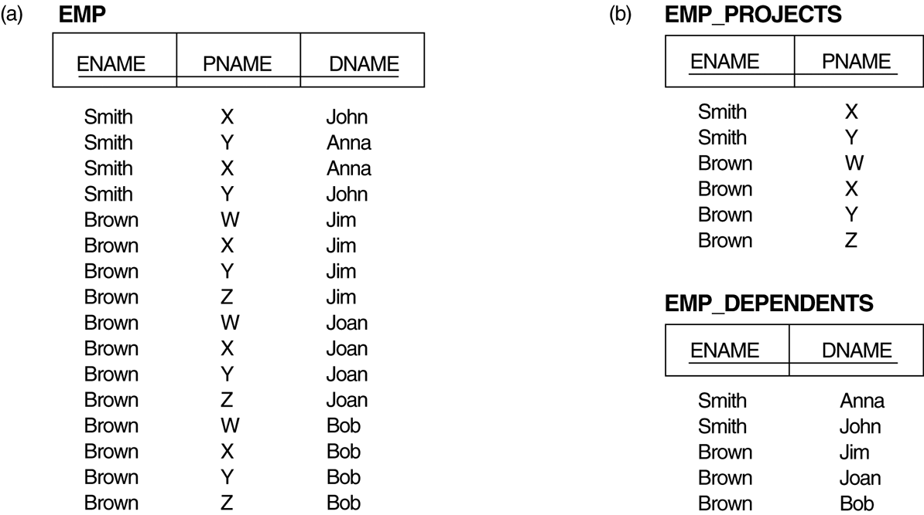
Fourth Normal Form (CO 5)
Decomposing a relation state of EMP that is not in 4NF:
EMP relation with additional tuples.
Two corresponding 4NF relations EMP_PROJECTS and EMP_DEPENDENTS.

Slide 66
Join Dependency (CO 5)
Definition:
A join dependency (JD), denoted by JD(R₁, R₂, ..., R_{n}), specified on relation schema R, specifies a constraint on the states r of R.
The constraint states that every legal state r of R should have a non-additive join decomposition into R₁, R₂, ..., R_{n}; that is, for every such r we have
* (π_{R1}(r), π_{R2}(r), ..., π_{Rn}(r)) = r
Note: an MVD is a special case of a JD where n = 2.
A join dependency JD(R₁, R₂, ..., R_{n}), specified on relation schema R, is a trivial JD if one of the relation schemas R_{i} in JD(R₁, R₂, ..., R_{n}) is equal to R.

Slide 67
Fifth Normal Form (CO 5)
Definition:
A relation schema R is in fifth normal form (5NF) (or Project-Join Normal Form (PJNF)) with respect to a set F of functional, multivalued, and join dependencies if,
for every nontrivial join dependency JD(R₁, R₂, ..., R_{n}) in F⁺ (that is, implied by F),
every R_{i} is a superkey of R.

Slide 68
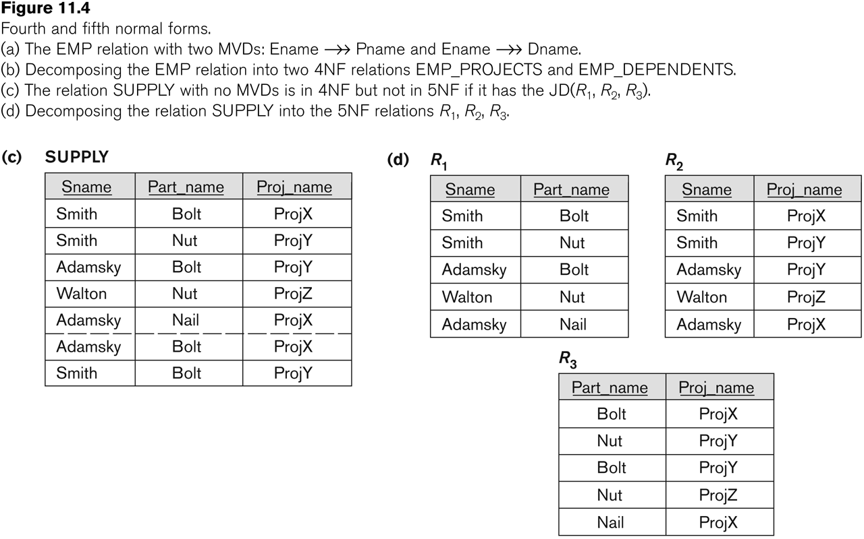
Fifth Normal Form (CO 5)

Slide 69
Domain-Key Normal Form (DKNF) (CO 5)
Definition:
A relation schema is said to be in DKNF if all constraints and dependencies that should hold on the valid relation states can be enforced simply by enforcing the domain constraints and key constraints on the relation.

Slide 70
Faculty Video Links, Youtube & NPTEL Video Links and Online Courses Details
Self Made Video Link:
You tube /other Video Links
https://nptel.ac.in/courses/106/104/106104135/
https://nptel.ac.in/courses/106106220/
https://www.youtube.com/watch?v=wQB_6o1UQa0
https://www.youtube.com/watch?v=7B9FnIIIsQc

Slide 71
MCQ
1. The relational database environment has all of the following components except
a. users
b. separate files
c. database
d. query languages
e. Database
2. A second Normal form does not permit ...... dependency between a non prime attribute and the relation key ?
Partial
Multi
Functional
Valued
3. A relation scheme is in ..... if it is in the 1NF and if all non prime attributes are fully functionally dependent on the relation key ?
First Normal Form
Second Normal Form
Boyce Codd Normal Form
Fourth Normal Form
Answer = D
4. In a Third Normal Form relation, every ......attribute is non - transitively and fully dependent on the every candidate key ?
Prime
Non Prime
Unique
None of these
Answer = C

Slide 72
MCQ
5. What is the purpose of the description column in Table Design View?
a. To define the data type applied to each field within the table
b. To describe the data that should be entered in each field
c. To enter lookup data that the field should refer to.
d. None of the ablve
.6. What is the propose to a sub datasheet?
a. To provide a hierarchial view of related tables or queries in a single window
b. To display grouped data in a report
c. To display summarized data.
d. All of the above
https://forms.gle/nKxypVtDqXdpRFRq6

Slide 73
Weekly Assignment 3.2
1. Find the highest normal form of a relation R(A, B,C,D,E) with FD set (A->D,B->A,BC->D,AC->BE) CO5
ANS: two candidate keys {AC, BC}. 1 Normal Form
2. Find the highest normal form of a relation R(A,B,C,D,E) with FD set as {BC->D,AC->BE,B->E} CO5
ANS: candidate key{AC} 2 Normal Form
3.. Find the highest normal form of a relation R(A,B,C,D,E) with FD set {B->A,A->C,BC->D,AC->BE} CO5
4. Consider a schema R(A, B,C,D) and functional dependencies A->B and C->D. Then the decomposition of R into R1 (A,B) and R2(C,D) is CO5
(a) dependency preserving and lossless join
(b) lossless join but not dependency preserving
(c) dependency preserving but not lossless join
(d) not dependency preserving and not lossless join

Slide 74
Weekly Assignment 3.2 contd..
5. A table has fields F1,F2,F3,F4, and F5, with the following functional dependencies: F1->F3 CO5
F2->F4
{F1,F2}->F5
in terms of normalization, this table is in
(a) 1NF (b) 2NF (c) 3NF (d) None of these
6. Consider the following functional dependencies in a database: CO5
Date of Birth->Age
Name->Roll number
Age->Eligibility
Roll number->Name
Course number->Course name
{Roll number,Course number}->Grade
the relation {Roll number, Name,Date of birth, Age} is
(a) in second normal form but not in third normal form
(b) in third normal form but not in BCNF
(c) in BCNF
(d) in none of these

Slide 75
Important Question
What is normalization ? Explain the different types of Normal Form.
Write difference between BCNF Vs 3 NF
Explain the Primary Key, Super Key, Foreign Key and Candidate key with example.
Short Notes of the Following-
i) MVD or JD ii) Normalization with advantages
What is functional Dependency ? What do you mean by loss less decomposition

Slide 76
Faculty Video Links, Youtube & NPTEL Video Links and Online Courses Details
Self Made Video Link:
Youtube/other Video Links
https://www.youtube.com/watch?v=1yUkun2r0N4
https://www.youtube.com/watch?v=EFdvRm5nse0

Slide 77
Daily Quiz
What is functional dependency?
Explain normal forms.
What is multi valued dependency?
Explain BCNF.
Explain redundancy.

Slide 78
Weekly Assignment
What do you mean by BCNF ? Why it is used and how it differ from 3 NF ? CO3
Discuss the various normal forms in normalization with suitable examples? Why is concurrency control needed? Explain lost update, Inconsistent retrievals and uncommitted dependency anomalies. CO3
Explain the Codd’s Rule in detail. CO3
Explain Normalization with example. CO3
What are the rules of 1NF,2NF,3NF. CO3
Discuss Boyce Codd Normalization Form. CO3

Slide 79
MCQ s
Which forms simplifies and ensures that there are minimal data aggregates and repetitive groups: a) 1NF b) 2NF c) 3NF d) All of the mentioned
For any pincode, there is only one city and state. Also, for given street, city and state, there is just one pincode. In normalization terms, empdt1 is a relation in a) 1 NF only b) 2 NF and hence also in 1 NF c) 3NF and hence also in 2NF and 1NF d) BCNF and hence also in 3NF, 2NF and 1NF

Slide 80
MCQ s
In the __________ normal form, a composite attribute is converted to individual attributes. a) First b) Second c) Third d) Fourth
Functional Dependencies are the types of constraints that are based on______ a) Key b) Key revisited c) Superset key d) None of the mentioned

Slide 81
Glossary Questions
Note: Fill in the blanks using Glossary:
( Unique, First, Third, Database, Key)
In the __________ normal form, a composite attribute is converted to individual attributes.
Functional Dependencies are the types of constraints that are based on________.
________ form simplifies and ensures that there are minimal data aggregates and repetitive group.
The relational database environment has all of the following components except__________.
In a Third Normal Form relation, every ______attribute is non - transitively and fully dependent on the every candidate key

Slide 82
Old Question Papers
http://www.aktuonline.com/papers/btech-cs-5-sem-data-base-management-system-KCS501-2020.pdf
http://www.aktuonline.com/papers/btech-cs-5-sem-database-management-system-KCS-501-2018-19.pdf
http://www.aktuonline.com/papers/btech-cs-5-sem-database-management-system-ncs-502-2017-18.pdf
http://www.aktuonline.com/papers/btech-cs-5-sem-database-management-system-ncs-502-2016-17.pdf

Slide 83
Expected Questions for University Exam
Explain normalization. What is normal form?
Describe the following terms :
(i) Multivalued dependency
(ii) Trigger
Why do we normalize database?
Define partial functional dependency. Consider the following two sets of functional dependencies F= {A ->C, AC ->D, E ->AD, E ->H} and G = {A ->CD, E ->AH}. Check whether or not they are equivalent.
What is Trigger? Explain different trigger with example.
Write difference between BCNF Vs 3 NF.

Slide 84
Summary
Knowledge of database design.
Knowledge of functional dependencies.
Knowledge of Normal forms.
Knowledge of Loss less join decomposition, Multivalued dependency and join dependency

Slide 85
Old Question Papers
https://drive.google.com/drive/u/0/folders/1gWUEwo7Ztpxs4smy34fl9jWQrx4AKpkC

Slide 86
Old Question Papers
http://www.aktuonline.com/papers/btech-cs-5-sem-data-base-management-system-KCS501-2020.pdf
http://www.aktuonline.com/papers/btech-cs-5-sem-database-management-system-rcs-501-2018-19.pdf
http://www.aktuonline.com/papers/btech-cs-5-sem-database-management-system-ncs-502-2017-18.pdf
http://www.aktuonline.com/papers/btech-cs-5-sem-database-management-system-ncs-502-2016-17.pdf

Slide 87
References
Korth, Silbertz, Sudarshan,” Database Concepts”, McGraw Hill
Date C J, “An Introduction to Database Systems”, Addision Wesley
Elmasri, Navathe, “ Fundamentals of Database Systems”, Addision Wesley
O’Neil, Databases, Elsevier Pub.
RAMAKRISHNAN"Database Management Systems",McGraw Hill
Leon &Leon,”Database Management Systems”, Vikas Publishing House
Bipin C. Desai, “ An Introduction to Database Systems”, Galgotia Publications
Majumdar& Bhattacharya, “Database Management System”, TMH
R.P. Mahapatra, Database Management System, Khanna Publishing House

